Slide 1
AI Ethics & Safety
Nuffield Summer supervision project 2024

Slide 2
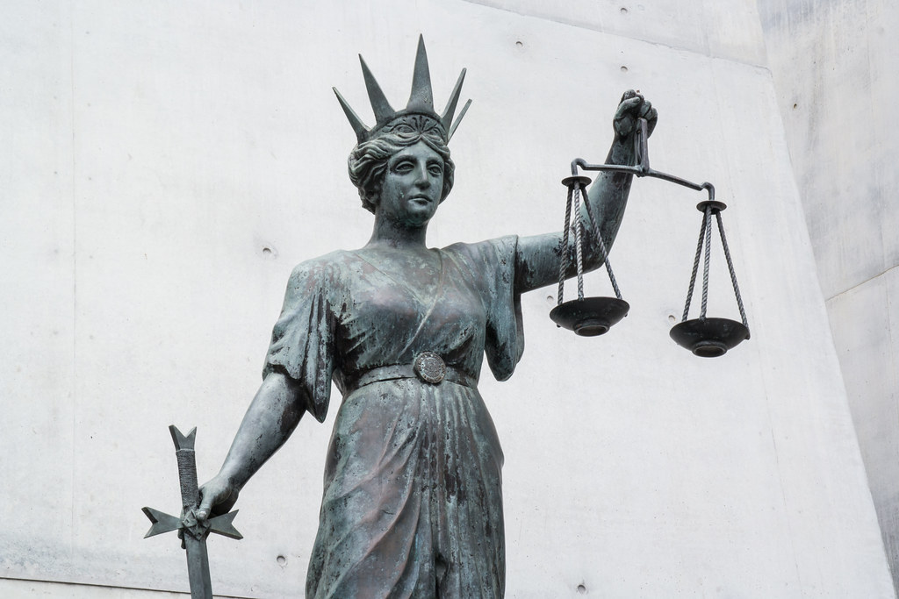
Contents
AI Ethics
Gain an understanding of AI Ethics
Scope
Identify and Understand the scope of AI Ethics and the implications for society.
Projects
Understand the ethical considerations you should make during your project.

Slide 3
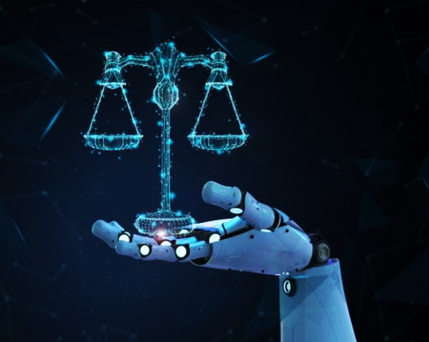
1. AI Ethics

Slide 4
AI Ethics
AI Ethics is concerned with the behaviour of human developers, manufacturers, operators, and businesses in order to minimise the harms that can arise from the use of AI by society at large.
The harms can arise from poor (unethical) design, or inappropriate application and misuse.
The main goal of AI Ethics is to develop AI Systems that conform to agreed upon ethical standards.

Slide 5
AI Ethics
Ethical AI
Responsible AI
What We Need Now: Ethical AI - UC Berkeley Sutardja Center
Responsible AI – Microsoft
Responsible AI – Google Cloud
Trustworthy AI
Explainable AI
Trustworthy AI: From Principles to Practices
Explainable AI – Google Cloud
Explainable AI - IBM
AI for Social Good
Equitable AI
AI for Social Good – Google AI
Equitable AI in the Workplace
AI Governance
Friendly AI
UK Parliament Committee – AI Governance
Centre for AI Governance
Friendly AI

Slide 6
AI Ethics
Why is AI Ethics Important?
Some AI Systems may affect human behaviour adversely!
Some AI Systems may not deliver correct information!
Some AI Systems may be discriminatory and harmful to humanity!
Some AI Systems may violate human morals and rights!

Slide 7
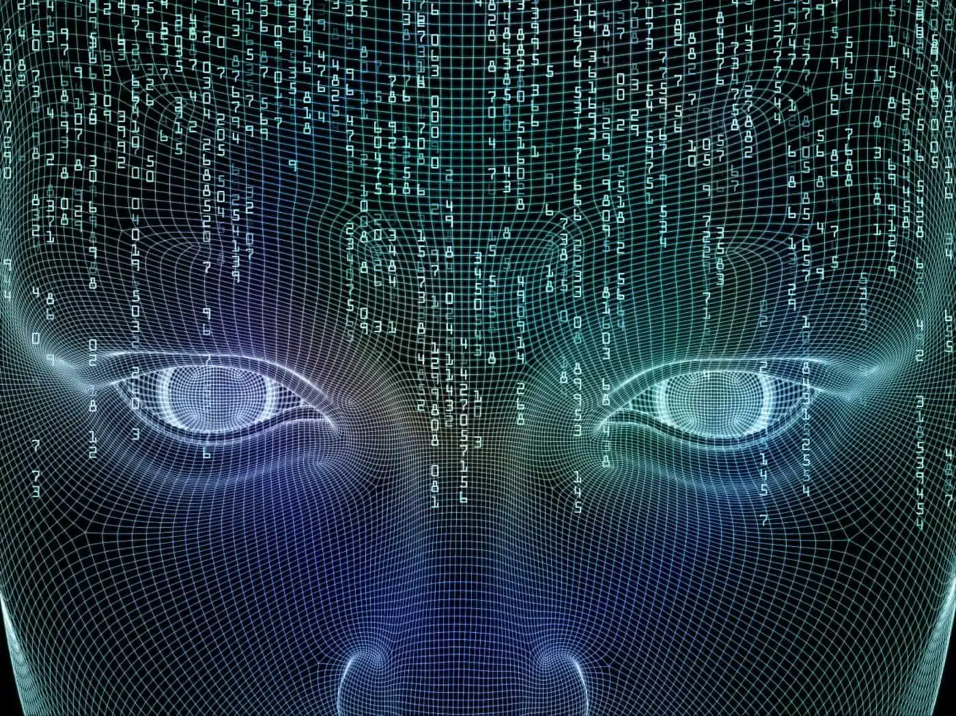
2. Scope

Slide 8
Scope
Bias & Fairness
Bias is an inclination of temperament or outlook; especially a personal and sometimes unreasoned judgment or prejudice.
“Bias”, Merriam-Webster.com, Merriam-Webster’s New Dictionary
In AI, ‘bias’ can refer to:
Declarative Bias: Prior beliefs and assumptions about the space of things possible to learn.
Statistical Bias: Systematic difference between the calculated value of a statistic and the true value of the parameter being estimated.
Cognitive Bias: A systematic pattern of deviation from rationality to judgement.
Stereotyping: An over-generalised belief about a particular category of people.
Prejudice: Beliefs or actions based largely or solely on a person’s membership in a group.
Bias can occur in data, in models, and in human cognition and analysis.
AFIRM_Kroll_Algorithmic-Bias-1 (sigir.org)

Slide 9
Scope
Bias & Fairness
Fairness can be defined according to multiple criteria:
Individual Fairness: Individuals are treated similarly to other similar individuals, regardless of their class.
Group fairness: A requirement that two classes are treated similarly, as measured by their summary statistics.
Fairness through unawareness: Machine learning algorithms can predict latent variables (such as race and gender) given other correlated variables (such as postcode and occupation).
Equal outcome: The idea that each demographic class gets the same results; they have demographic parity.
Equal opportunity: This approach is also called balance. Regardless of their sex, people who can pay back the loans should have equal chance of being correctly classified as such. This can lead to unequal outcomes and ignores the effect of bias in the society.
Equal impact: People with similar likelihood to pay back the loan should have the same expected utility, regardless of the class they belong to. This goes beyond equal opportunity because it considers both the benefits of true prediction and the cost of a false prediction.

Slide 10
Scope
Sometimes fairness means that we reconsider the objective function not the data or the algorithm.
An example is in making a job hiring decision; should the objective function be (1) to hire the best qualified candidates or (2) to hire the candidates with the best ability to learn?
Ensuring Fairness
Steps to ensuring fairness include:
Communication between software engineers, social scientists, and members of society to understand the issues and perspectives and consider fairness from the start.
Optimise for an objective function that incorporates / considers fairness.
Include system tests that reflect the experience of minority users.
Design goals for ensuring annotation accuracy.

Slide 11
Scope
Trust, Transparency, and Explainability
Trust is about the assurance that AI systems are accurate, fair, safe, and secure.
Transparency is the knowledge that a system is not working against a user; whether due to intentional malice, an unintentional bug, or pervasive societal bias that is recapitulated by the system in question.
Explainability helps to explain transparency; AI Systems that can explain themselves are known as Explainable AI (XAI).

Slide 12
Scope
Surveillance, Security, and Privacy
Surveillance is the monitoring of people; typically, via the subject's voice, face, or gait (movement of limbs). AI Engineers should be clear on what uses of surveillance are compatible with human rights and refuse to work on applications that are incompatible.
Security is how safe the system regarding outside attack, as well as how safe the system is regarding its potential to attack.
Privacy refers to how much information a user is entitled to keep to themselves; typically, in reference to their data.

Slide 13

3. Projects

Slide 14
Projects
During your projects, it is essential to not only proceed from an appropriate ethical position, but to likewise detail your ethical positions within your report.
By ‘ethical position’, we mean the considerations you make in order to maintain a project that adheres to the criteria outlined in this presentation.
Working with Emotional Recognition means (usually) working with images of human faces; we have provided an appropriately licensed dataset for you to undertake your project with, but should you want to use an alternative dataset, you must consider the ethical issues surrounding this choice.
Similarly, principles of bias, fairness, security, and privacy will be essential to your work.

Slide 15
Questions for Consideration
What ethical implications can you think of regarding emotional recognition?
How do you think you should align yourself ethically from the onset of your project?
How do you think ethics should be incorporated into your report? (prior to undertaken research? Following the obtaining of results? Both?)

